Slide 1
The Determinants of Decision Time in an Ambiguous Context
Anna Conte, Gianmarco De Santis, John D. Hey, Ivan Soraperra
Presentation at the Brown bag workshop Prince of Songkhla University Monday the 27th of November 2023

Slide 2
Introduction
This is a follow-up to the paper Conte, A. and Hey, J. (2013). Assessing multiple prior models of behaviour under ambiguity. Journal of Risk and Uncertainty, 46(2):113–132 – from now on C&H.
C&H categorized individual subjects as being of one of four types (of decision-maker) — Expected Utility, Smooth, Rank Dependent and Alpha MaxMin — by using the decisions of the subjects, but did not look at the decision times of the different types. We take as given the categorization identified by C&H, and explore whether the classification can explain the decision times of the subjects.
This paper is the first to investigate the heterogeneity of decision times based on a classification of subjects into different types in an ambiguous (rather than risky) decision context.

Slide 3
C&H
C&H classified subjects into one of four types of decision-makers under ambiguity, depending upon the model of their decision-making.
These types were the Expected Utility Model, the Smooth Model, the Rank Dependent Expected Utility Model and the Alpha MaxMin Model.
We fitted the best model for each subject, subject by subject; we also fitted a mixture model using all 19,668 observations. The classification into types was almost the same for each method.

Slide 4
The Experiment
Subjects faced 49 tasks, each involving several rounds of decisions, and each decision involved a choice between two two-stage lotteries. Each two-stage lottery is made of several one-stage lotteries. A one-stage lottery is composed of a certain number of red balls and a certain number of blue balls. One of the two-stage lotteries displayed on the screen is labelled “unchanging lottery and the other “changing lottery”.
Before subjects are asked to make any choices, the computer randomly selects a one-stage lottery for the changing lottery, but but does not give this information to the subjects. We refer to this as the “actual lottery”.
The lottery played out at the end of a task is either the “actual lottery” or the one preferred to it by the subject at the end of a task.

Slide 5
Characterisation of Ambiguity in the Conte and Hey (C&H) Experiment
Risk is when probabilities are known.
Ambiguity is when probabilities are not known or are difficult to calculate.
We did not use the Bingo Blower, nor the Ambiguity Box, nor Ellsberg Urns as our characterisation.
We used multi-stage lotteries, represented diagrammatically.

Slide 6
Playing out a lottery
At the end of the experiment, one of the 49 tasks was chosen at random, and the subject’s preferred lottery was played out.
If a lottery is to be played out, an ‘urn’ is filled with the appropriate numbers of balls of each colour and one ball is drawn at random; if the ball is the colour chosen (earlier) by the subject, then the subject was paid an extra €40 in addition to the €7.5 of the show-up fee. If it was not, then there was no extra payment.

Slide 7
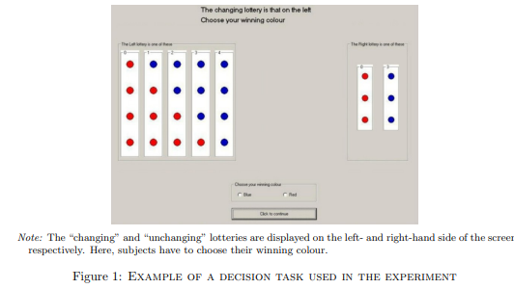
Example of a decision screen in the experiment

Slide 8
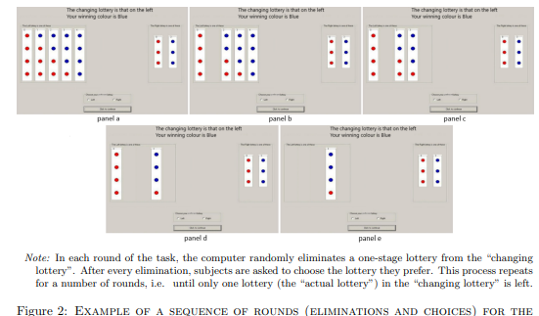
Example of a sequence of rounds

Slide 9
The ‘actual lottery’
Before subjects are asked to make any choices, the computer randomly selects a one-stage lottery from the changing lottery, but does not give this information to the subjects. We refer to this as the ‘actual lottery’, which is the one-stage lottery that will be played out for real at the end of the experiment if that task is selected.

Slide 10
The Experimental Procedure
A task proceeded as follows. First thing, subjects were asked to choose a “winning colour” (blue or red). This is the colour that they want to bet on, and once chosen, it could not be changed for that specific task. A visual example of a task and colour choice is shown in the figure above. A series of rounds starts at this point and subjects are required to make a choice between the two lotteries in each of them.
In all rounds, they had to select which of the two-stage lotteries they prefer, the “changing” or the “unchanging” one. After each round, one of the one-stage lotteries (crucially not the “actual lottery”) is selected at random by the computer and eliminated from the “changing lottery”, leaving a visual gap. Subjects are asked once again which is their preferred two-stage lottery, and then a new round starts. The process goes on until the “actual lottery” is the only one left in the “changing lottery”

Slide 11
Estimation/Fitting
As noted earlier, our goal was to find the best explanation for the behaviour of the subjects.
We proceeded on two fronts.
First, we fitted by maximum likelihood the four functionals and found the best-fitting type for each subject.
Second, we fitted a mixture model to all the data and hence found the proportions of each type.
The results were very similar (see the next slide).

Slide 12
Assignment of subjects to types from C&H

Slide 13
For those of you interested in technical detail, we give some in the next slide.

Slide 14
Functional forms for the two-stage lotteries (note u(7.5)=0 and u(47.5)=1 without loss of generality)
Expected Utility theory:
The Smooth Model
The Rank Dependent Expected Utility Model
The Alpha MaxMin Model
where
ϕ (x) = (1−e ^{−sx})/(1−e ^{−s}) and h (p) = p^{g}/[(p^{g} + (1−p)^{g})]^{1/g}

Slide 15
Summary statistics of decision times per type.
These statistics suggest that there are significant pairwise differences in the variances but not in the means of the decision times for EU, SM and RD subjects. This holds for both the estimation and the validation samples.

Slide 16
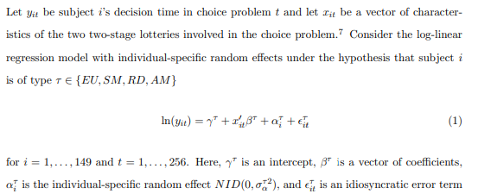
The econometric model of decision time

Slide 17
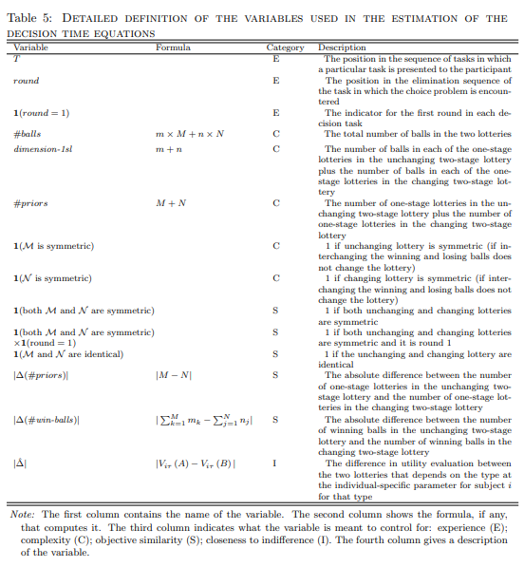

Slide 18
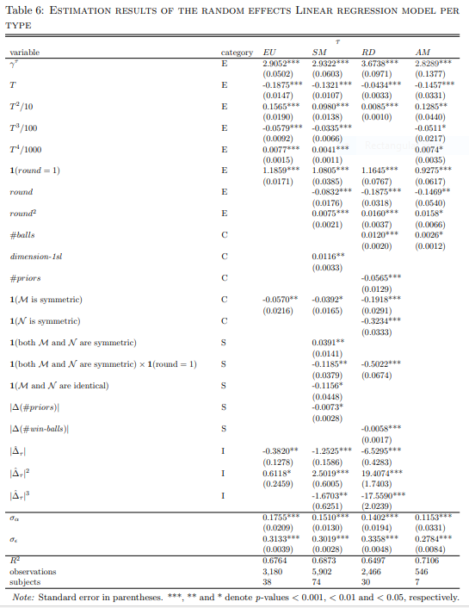

Slide 19
Summary
Result 1: Experience significantly reduces decision time both across and within tasks for all the types. This result is in line with our expectations and with the sequential effect described by Drift Diffusion Models.
Result 2: A task appears more complex, so requiring a higher cognitive effort and increasing decision time, the higher the number of balls it contains. The same holds for the dimensionality of the first-stage lotteries. Rather surprisingly, the number of priors reduces the cognitive load for RD types, and consequently their decision times. The symmetry of the two-stage lotteries expedites decisions.
Result 3: Objective similarity is extremely relevant for SM subjects while RD subjects are affected only partially. It has no significant effects on decision time for EU and AM types.
Result 4: The utility gap between the two two-stage lotteries in a decision problem and its powers, representing closeness to indifference, have a statistically significant effect on the decision times of EU, SM and RD subjects. As the utility gap grows, these subjects tend to reduce their decision times, although the effect is very strong for RD and mild for EU subjects. Closeness to indifference seems to be irrelevant for AM subjects.

Slide 20
Validation of decision times across types
Here we describe a validation exercise that enables us to test whether the decision times of a certain type of decision-maker under ambiguity are best predicted by the model of decision time estimated for that type with respect to that estimated for the other types.
The following table displays the results of this exercise. For the validation sample of each of the types, the aforementioned joint null hypothesis cannot be rejected always when the predicting model is that of the corresponding type, which is also the case with the highest R² when the joint null cannot be rejected for more than one predicting model (namely, predictors EU and SM for the EU validation data and RD and AM for the RD validation data). The RMSE criterion always indicates the best predictor of decision time for a particular type is the model specific to that type.

Slide 21
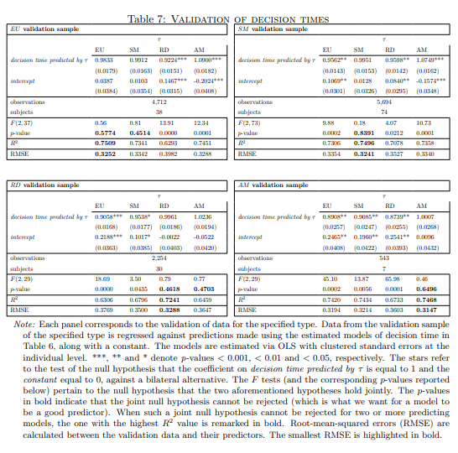

Slide 22
Conclusion 1
At first sight, decision times seem not to differ between types greatly, as shown by the summary statistics in the summary table above. However, when considering the various factors that could influence decision time, following the econometric analysis by Moffatt (2015), we discover significant differences between decision types. These differences are evident in how decision types allocate time to factors such as experience, complexity, similarity, and closeness to indifference,
Rather obviously, decision time decreases, at a decreasing rate, throughout the experiment for all types of subjects. What is interesting is that not only do different types have different preference functionals, but they also seem to be processing the problems differently. Indeed there seems to be a connection between the type of the subjects and the way they allocate their decision time.

Slide 23
Conclusion 2
In conclusion, the main contribution of this paper lies in its expansion of the literature on decision times, particularly in terms of understanding the decision-making processes of different types of decision-makers under ambiguity. By incorporating psychological theories regarding the cognitive processes underlying different decision rules, we delve deeper into the subject matter.

Slide 24
The end
Comments welcome.
Thank you for your attention and hospitality.
If you have questions that you would prefer not to ask now, you can send me an email at john.hey@york.ac.uk.
John Hey

